Slide 1

Python-based Phishing Detection Tool

Slide 2
Introduction
Phishing emails are a major cybersecurity threat
Attackers use social engineering and technical deception
The project aims to detect phishing emails using rule‑based analysis

Slide 3
Application Domain
Email security within the cybersecurity domain
Phishing as a common attack vector
Targets individuals and organisations
Focus on detection and prevention of malicious emails
Reducing the risk of credential theft and financial fraud

Slide 4
Technologies Used in the Prototype
Rule‑based phishing detection techniques
Text analysis for social engineering patterns
URL analysis for malicious link detection
Python as an implementation language

Slide 5
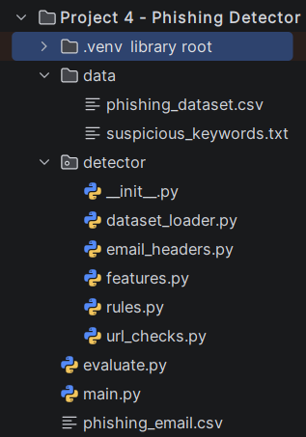
System Architecture
main.py:
Manual email analysis
User inputs message and URL
evaluate.py:
Automated dataset evaluation
Measures detection accuracy

Slide 6
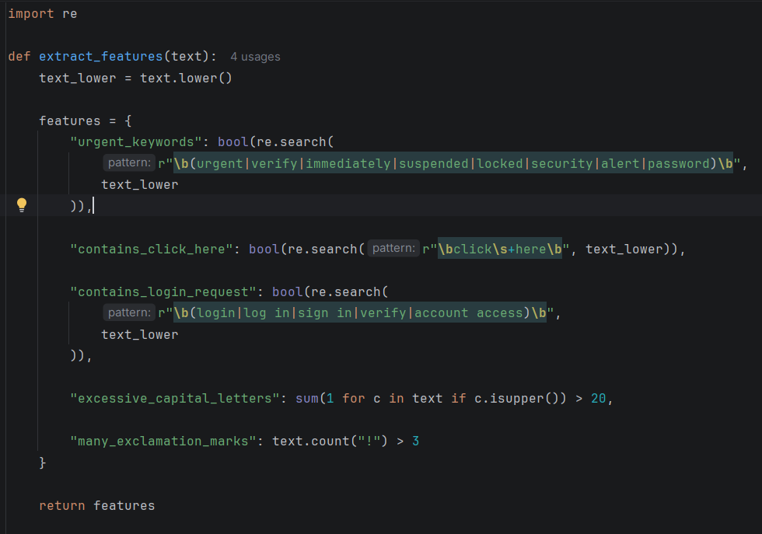
Prototype – features.py

Slide 7
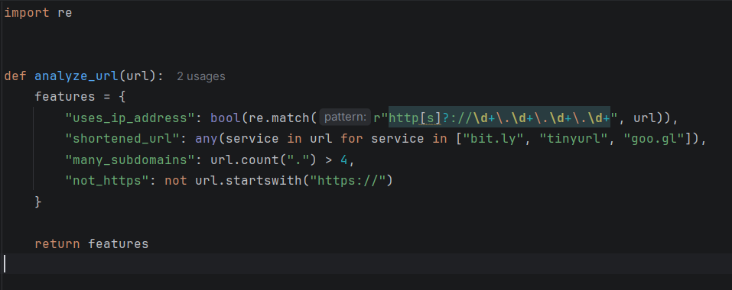
Prototype – url_checks.py

Slide 8
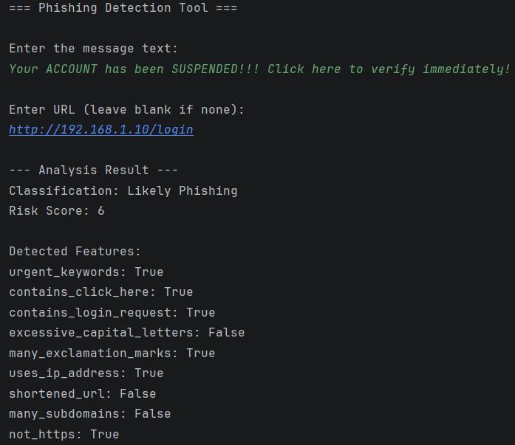
Prototype Results – main.py

Slide 9
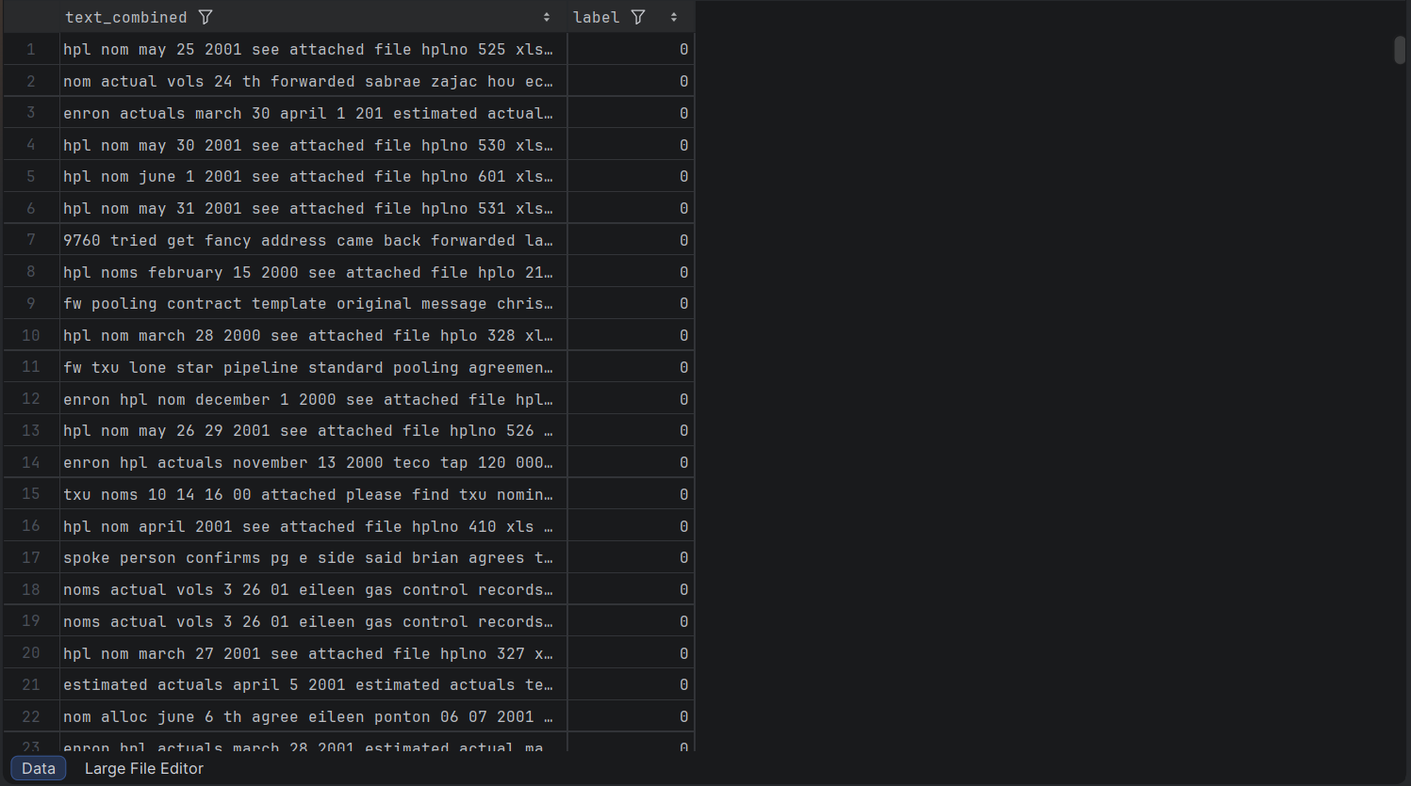
Dataset from Kaggle

Slide 10
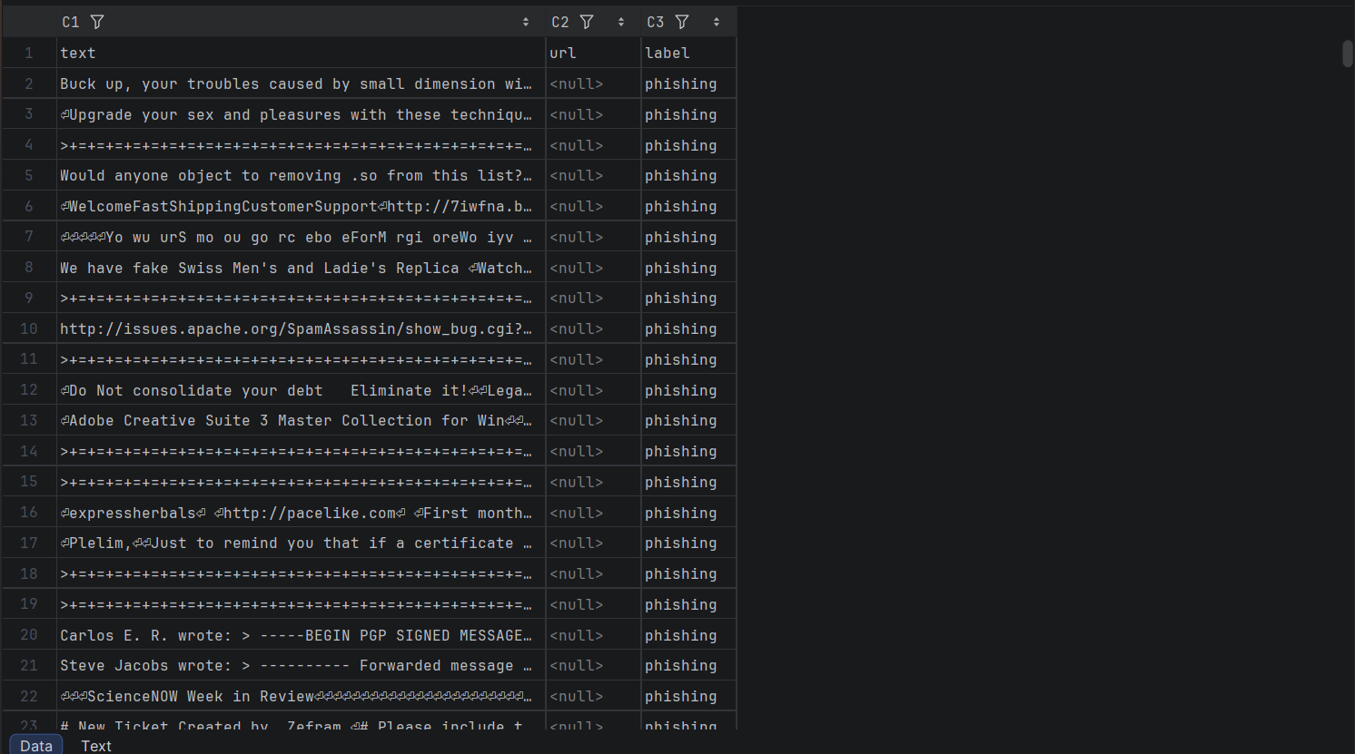
Extracted Dataset

Slide 11

Prototype Result – evaluation.py

Slide 12

Final Requirements
Completed So Far:
Analyse email text for phishing indicators
Analyse URLs for suspicious characteristics
Extract rule‑based features (keywords, URL patterns)
Generate a cumulative risk score
Classify emails as:
Likely Safe
Suspicious
Likely Phishing

Slide 13
Final Requirements – Planned Enhancements
Machine Learning Integration (scikit‑learn):
Use extracted features as input to ML models
Train classifiers such as:
Logistic Regression
Random Forest
Compare model performance using accuracy and precision.
Build a hybrid system combining Rule‑based detection and Machine learning detection.
Improve Evaluation Accuracy:
Expand dataset with more phishing and legitimate samples
Perform feature scaling and preprocessing
Use cross‑validation to reduce overfitting
Tune model hyperparameters to improve performance
Analyse false positives and false negatives to refine rules and features

